Slide 1
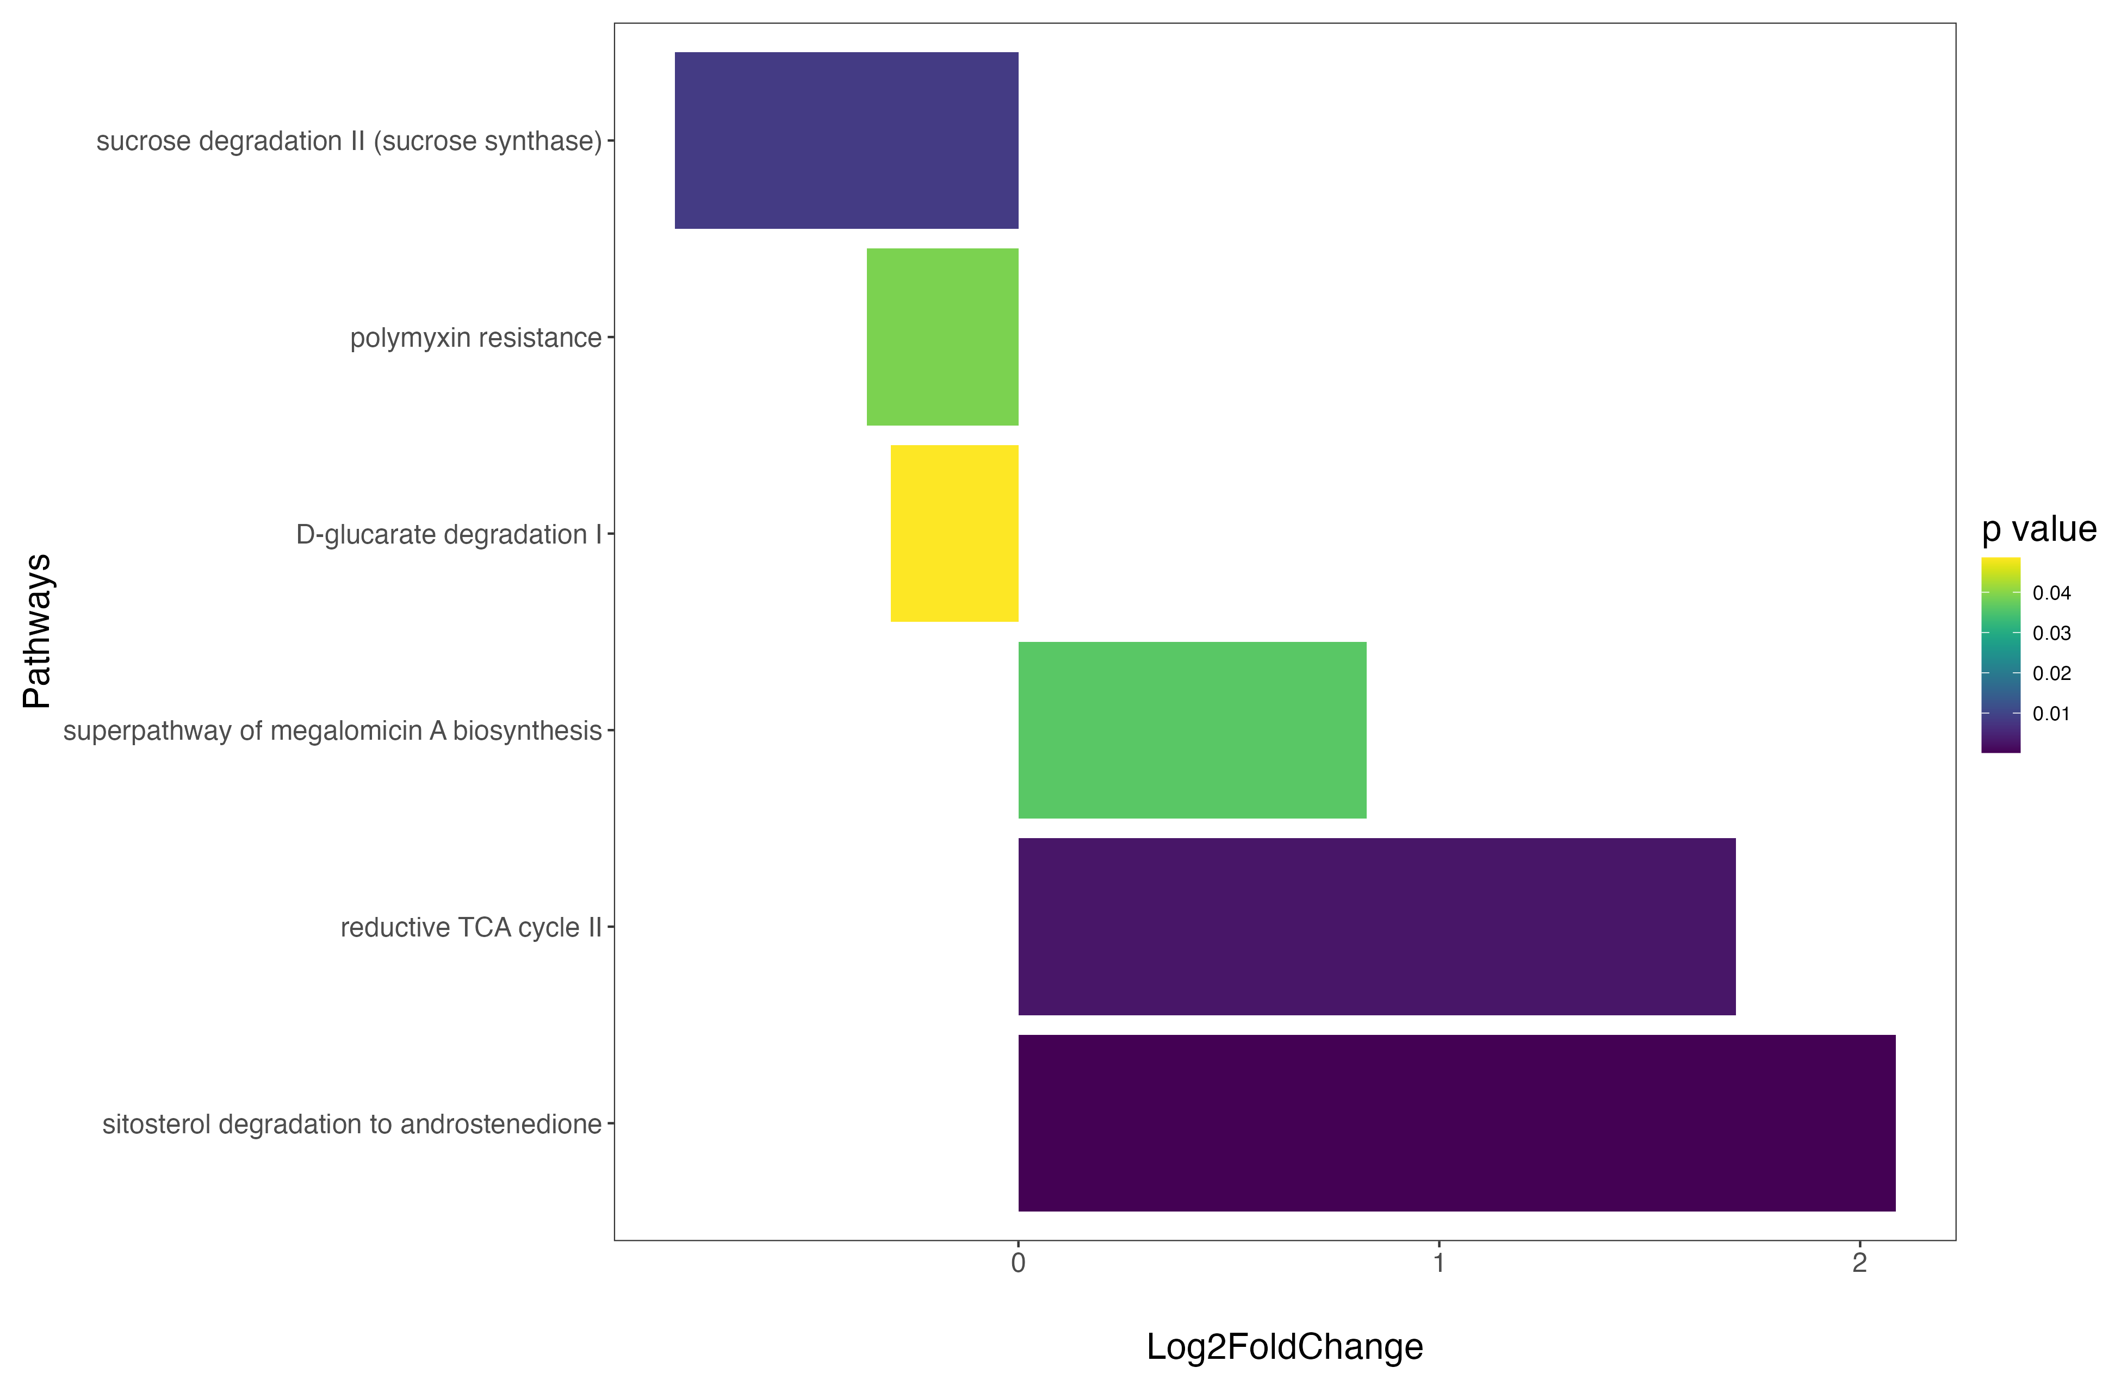

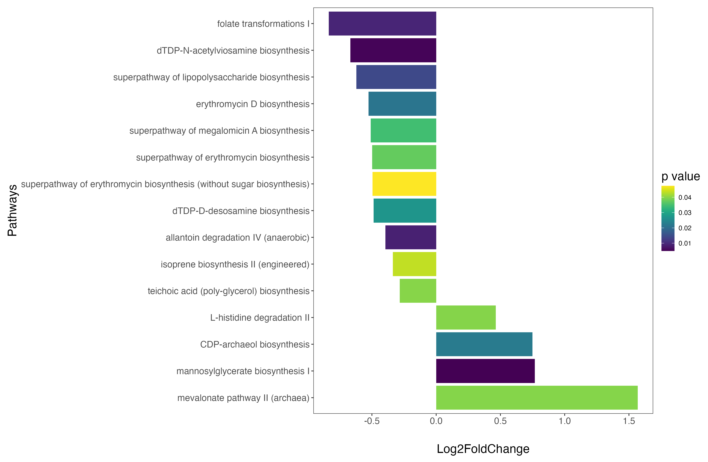
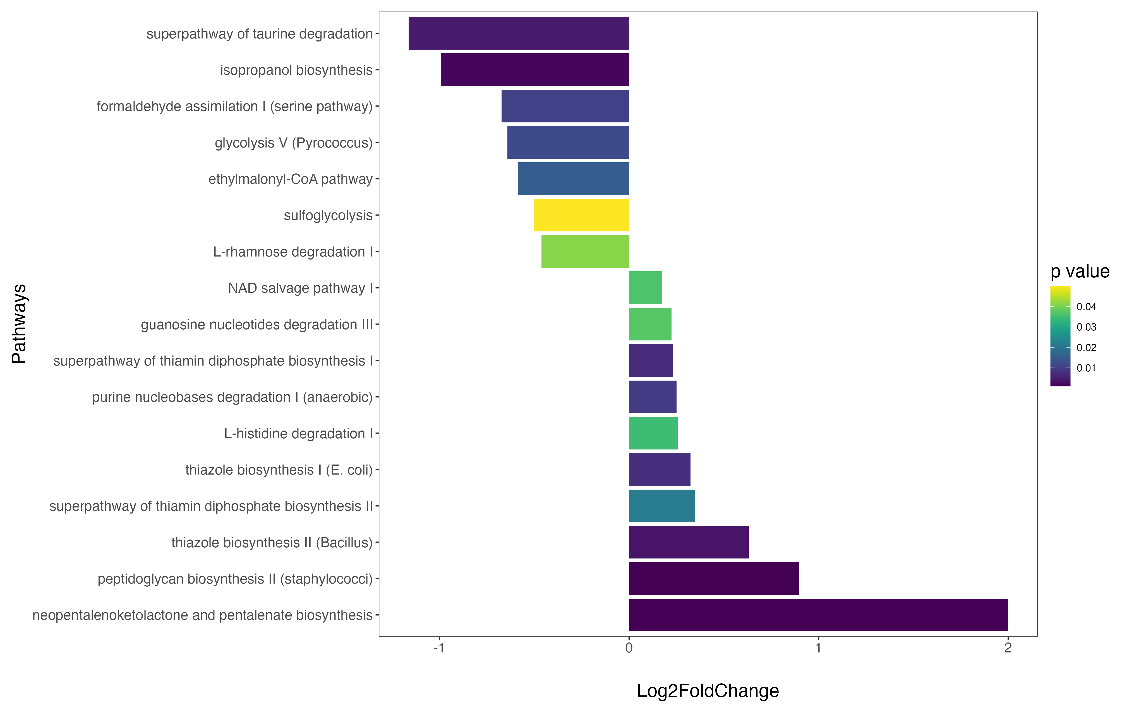
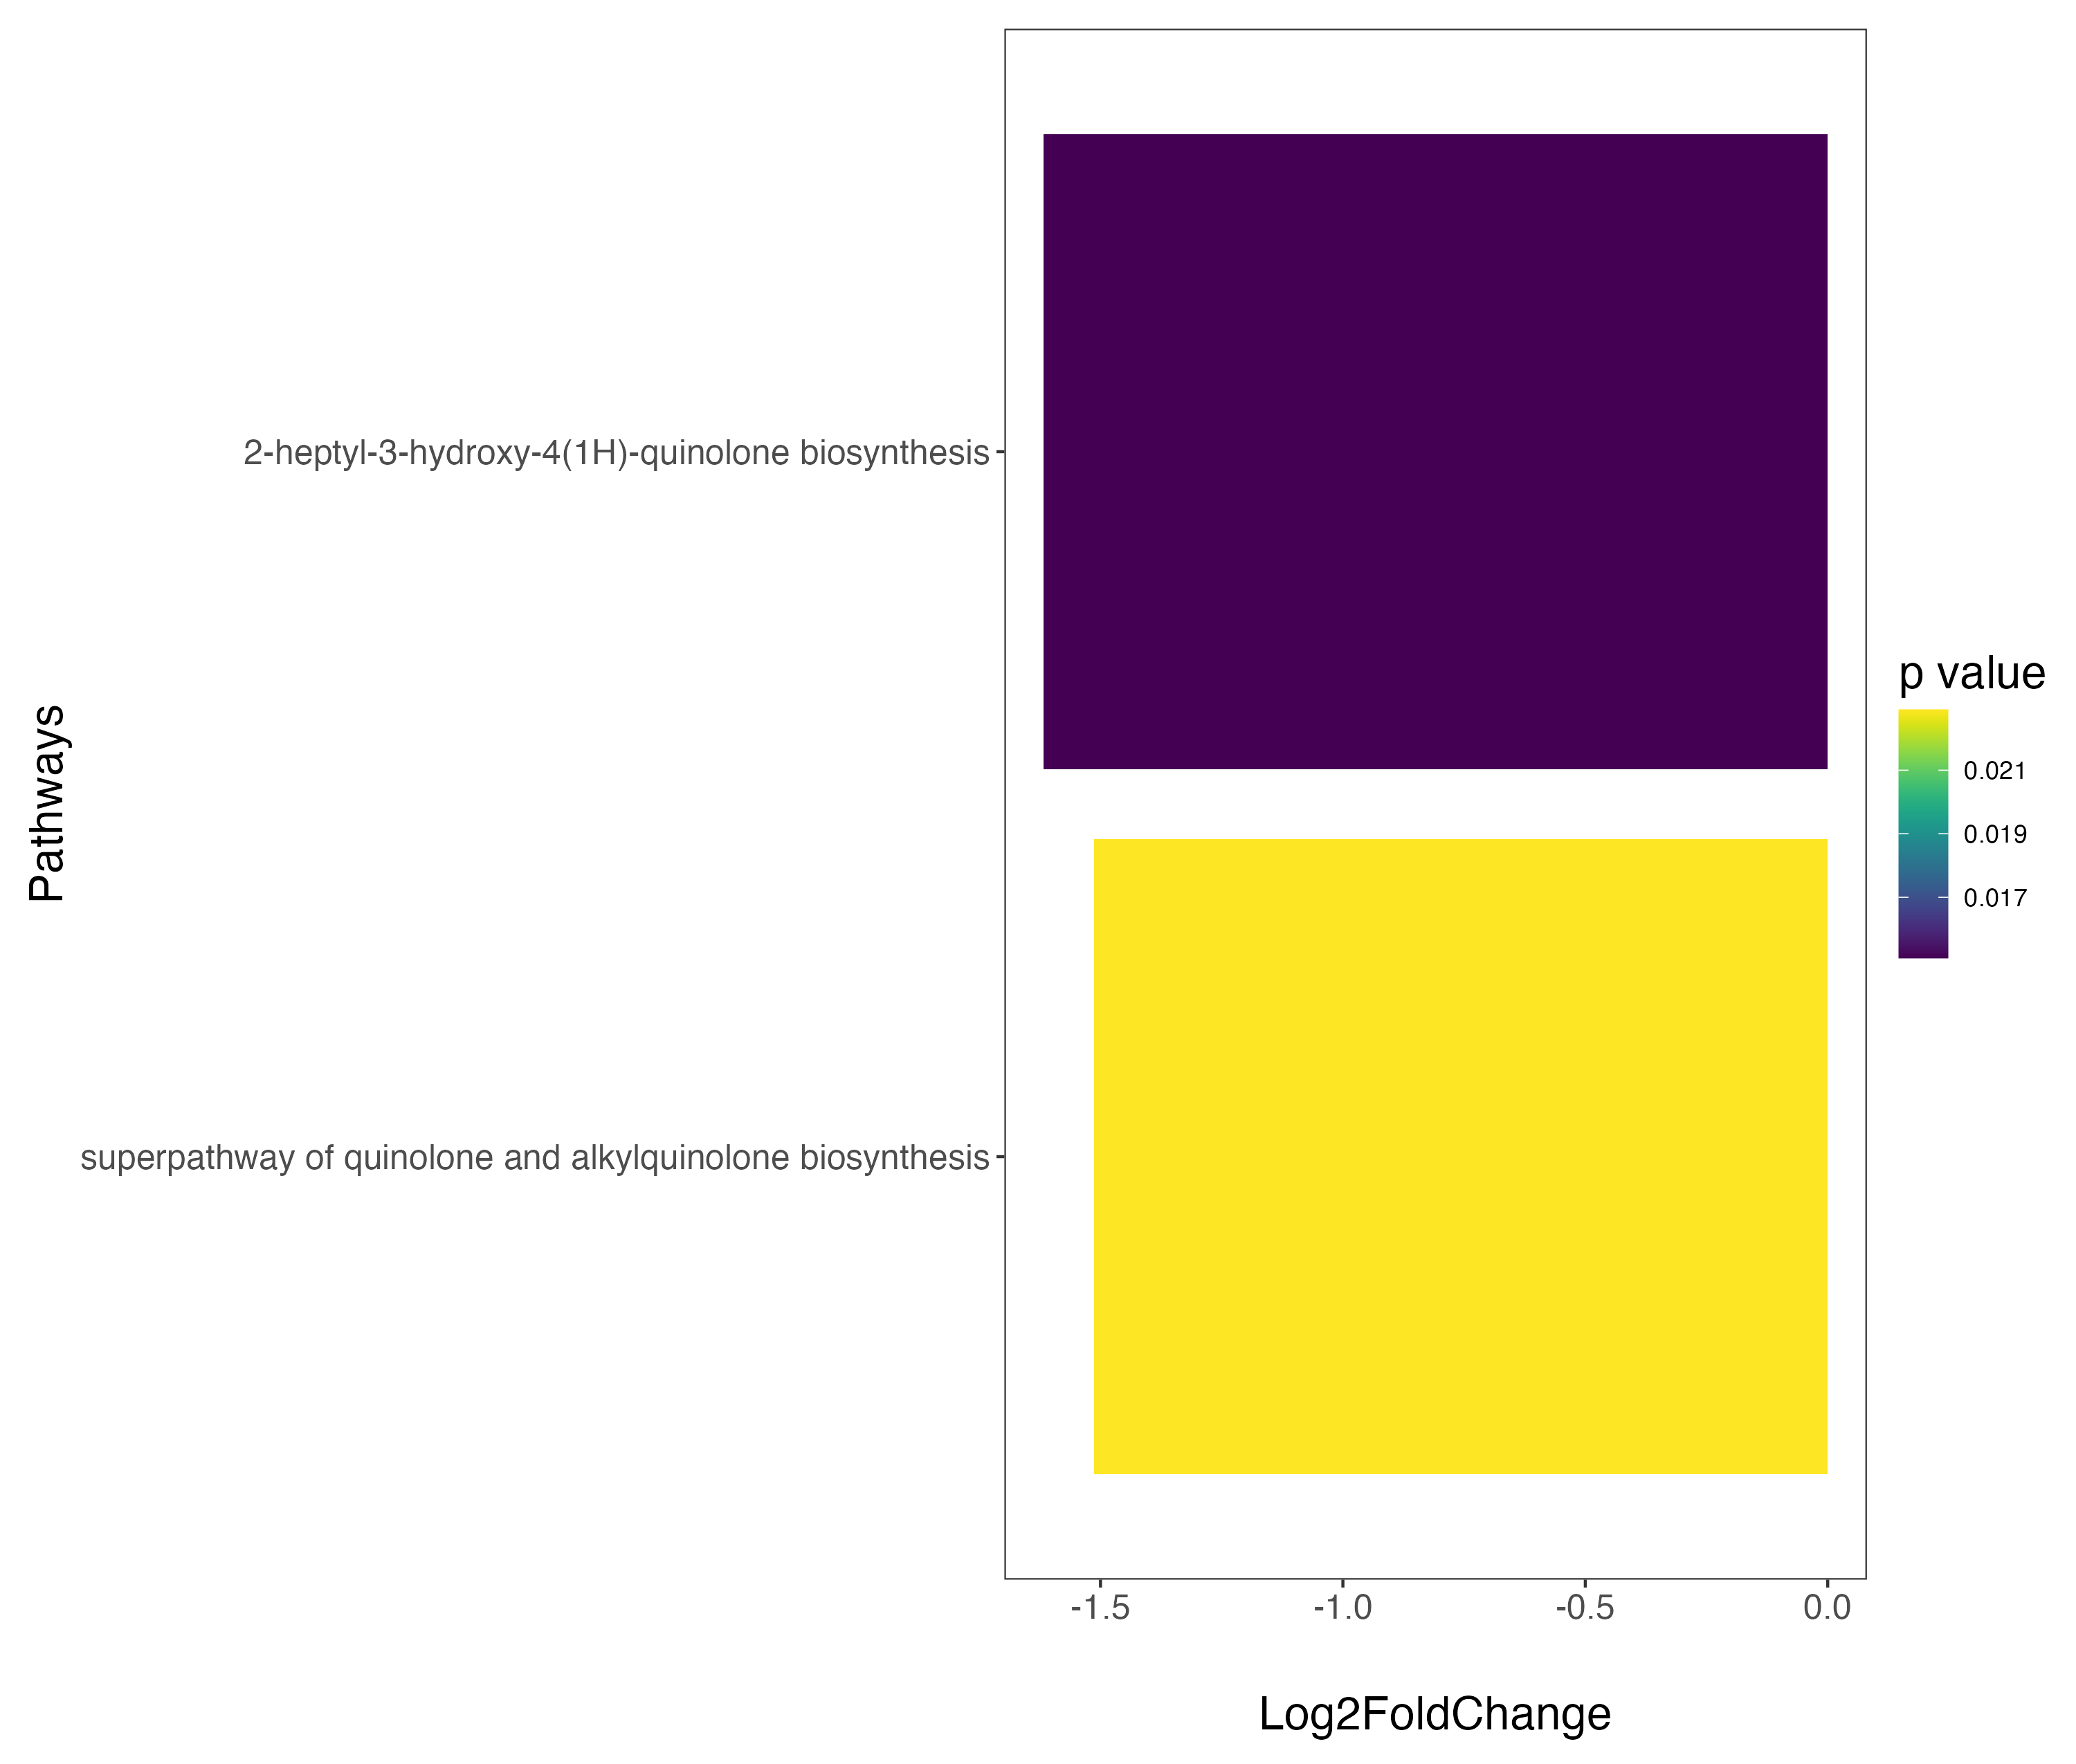
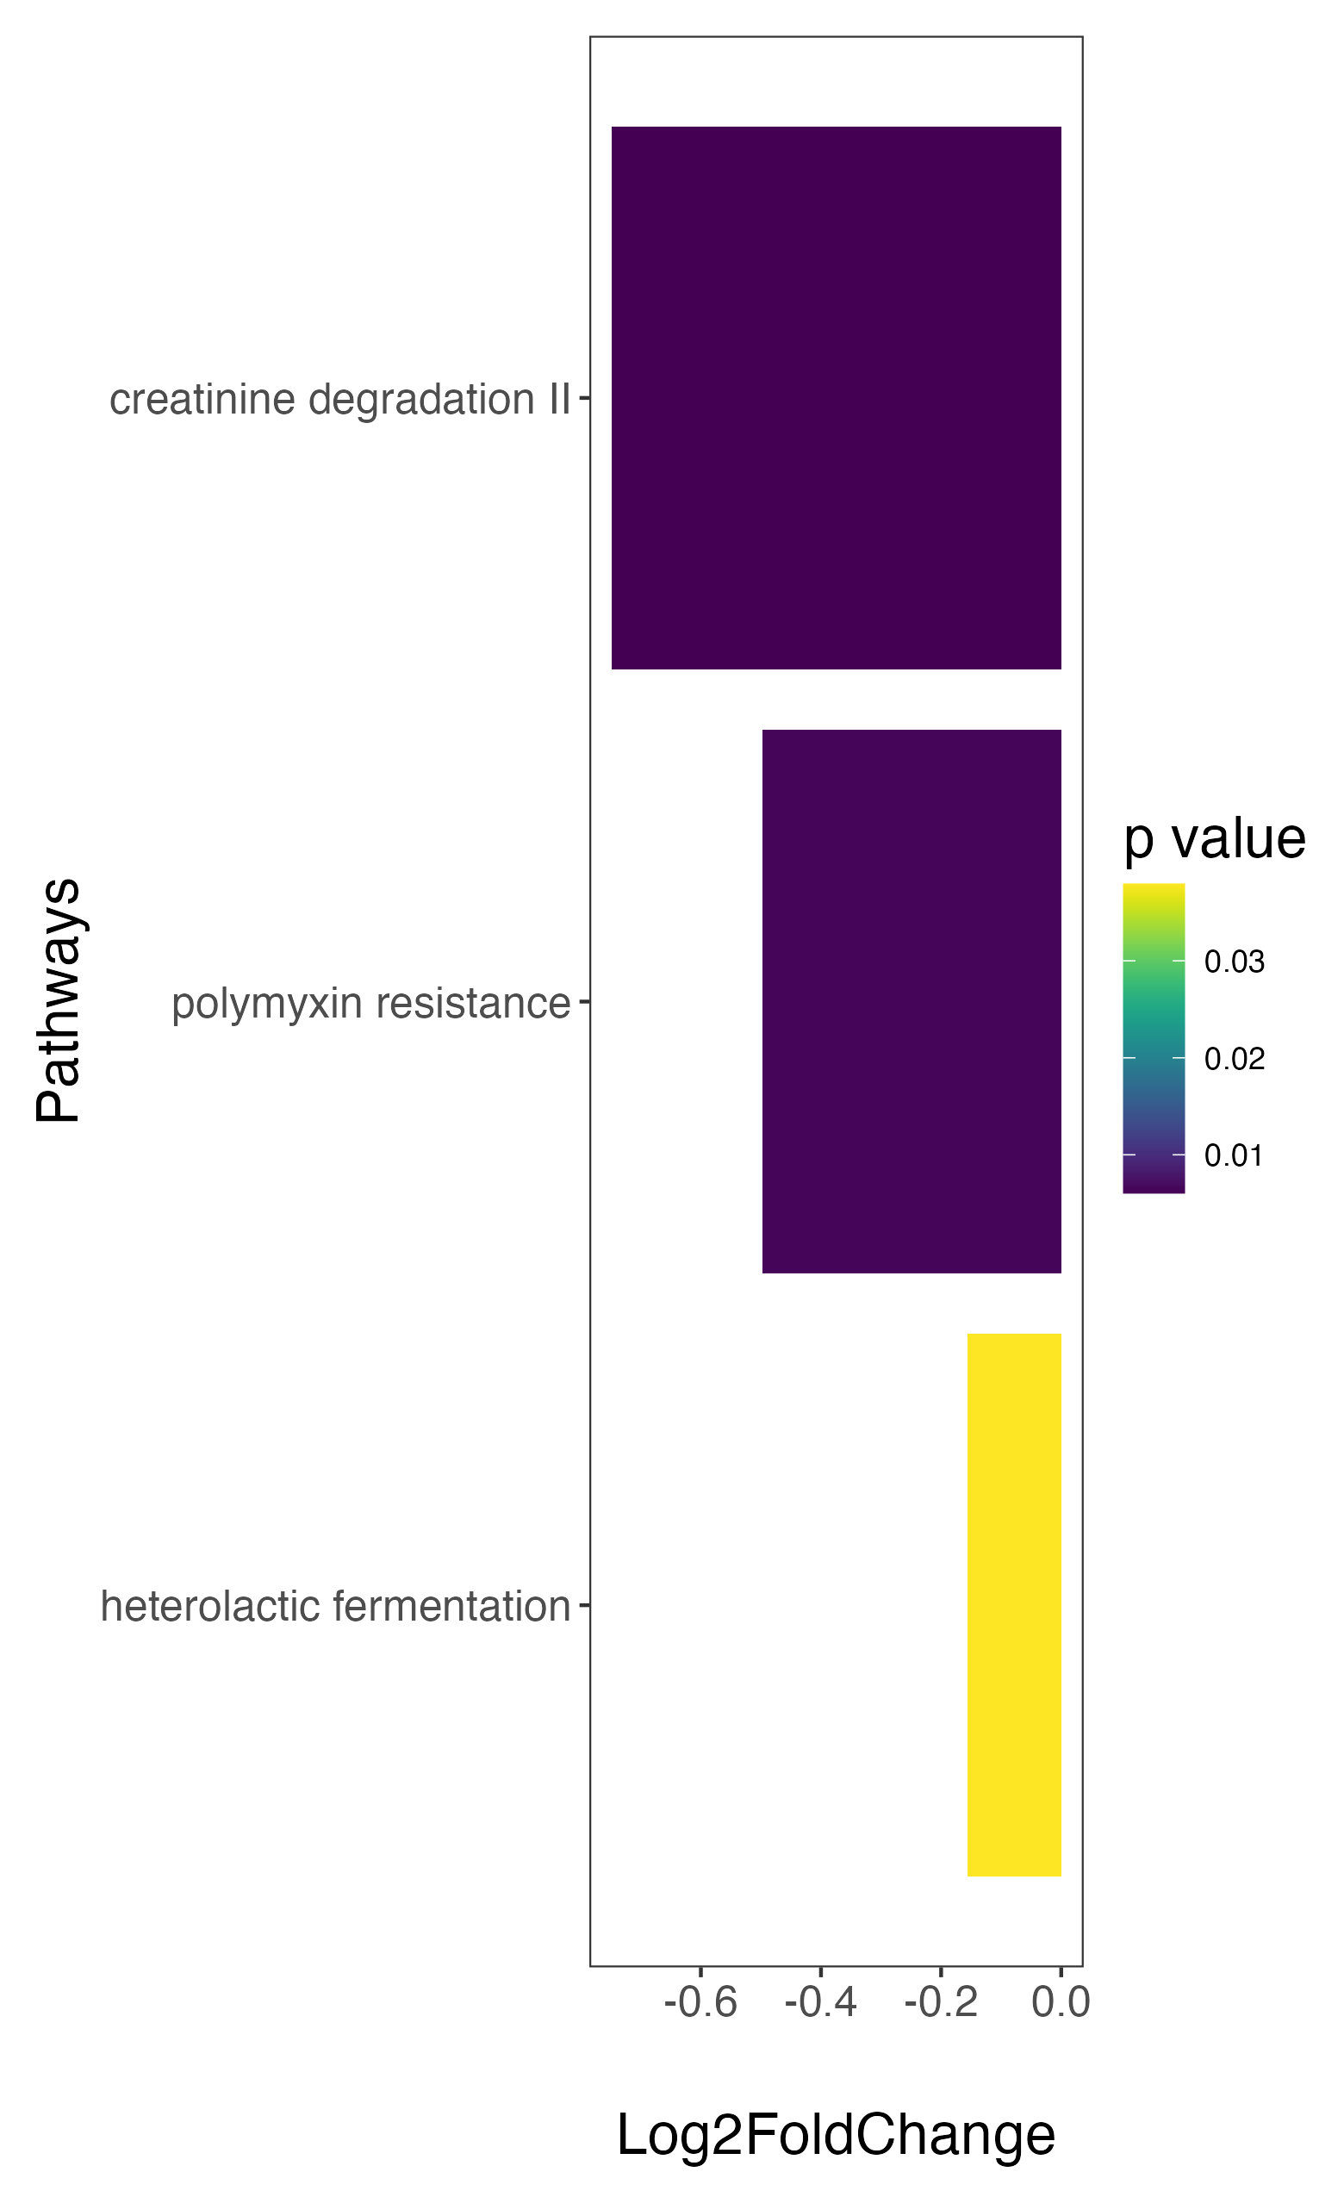
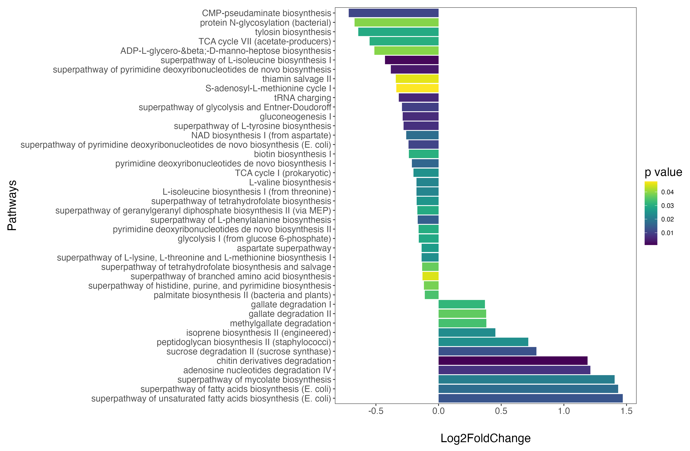
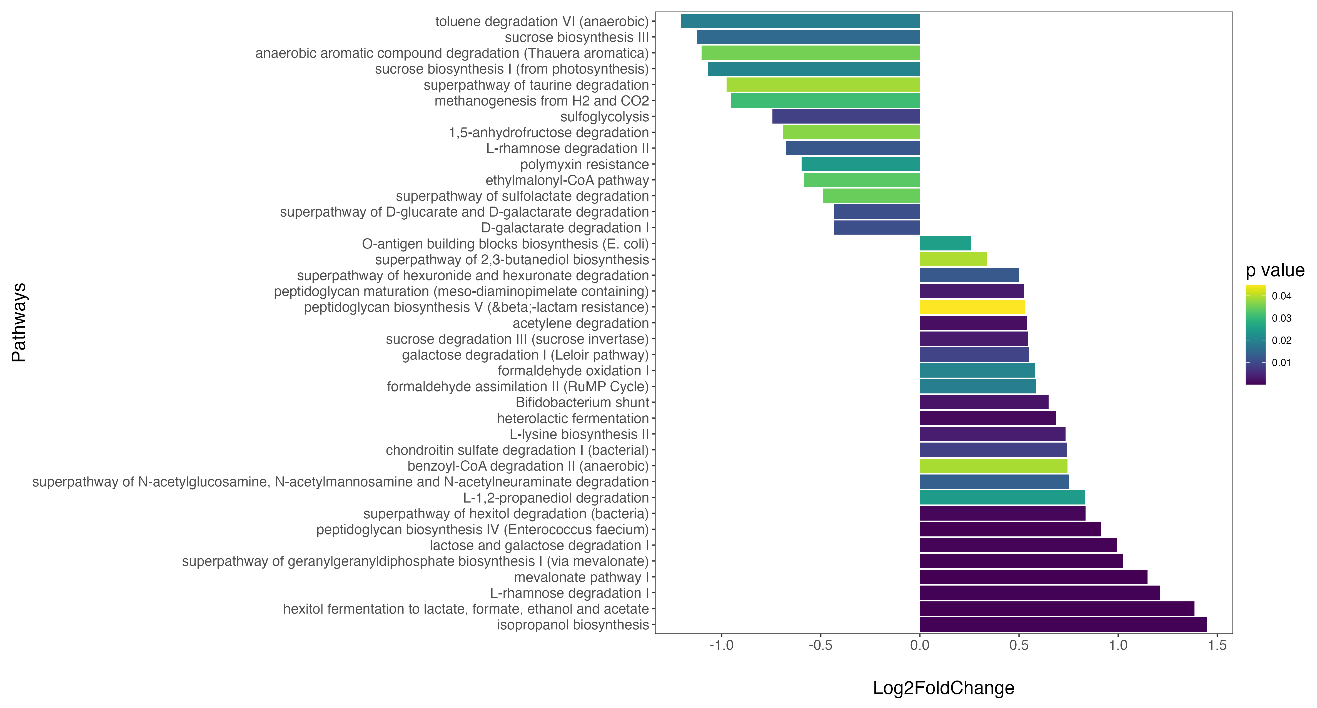
a
down-represented in H. pylori positive
up-represented in H. pylori positive
down-represented in H. pylori positive
up-represented in H. pylori positive
down-represented in H. pylori positive
up-represented in H. pylori positive
down-represented in H. pylori positive
up-represented in H. pylori positive
b
down-represented in Fusobacterium low
down-represented in Fusobacterium low
down-represented in Fusobacterium low
up-represented in Fusobacterium low
down-represented in Fusobacterium low
up-represented in Fusobacterium low

